Slide 1
Database Merger
Database Design Team
Samuel Germain
Warren Fehr
Richard Granger
Mohammed Kassem
Vigor

Slide 2
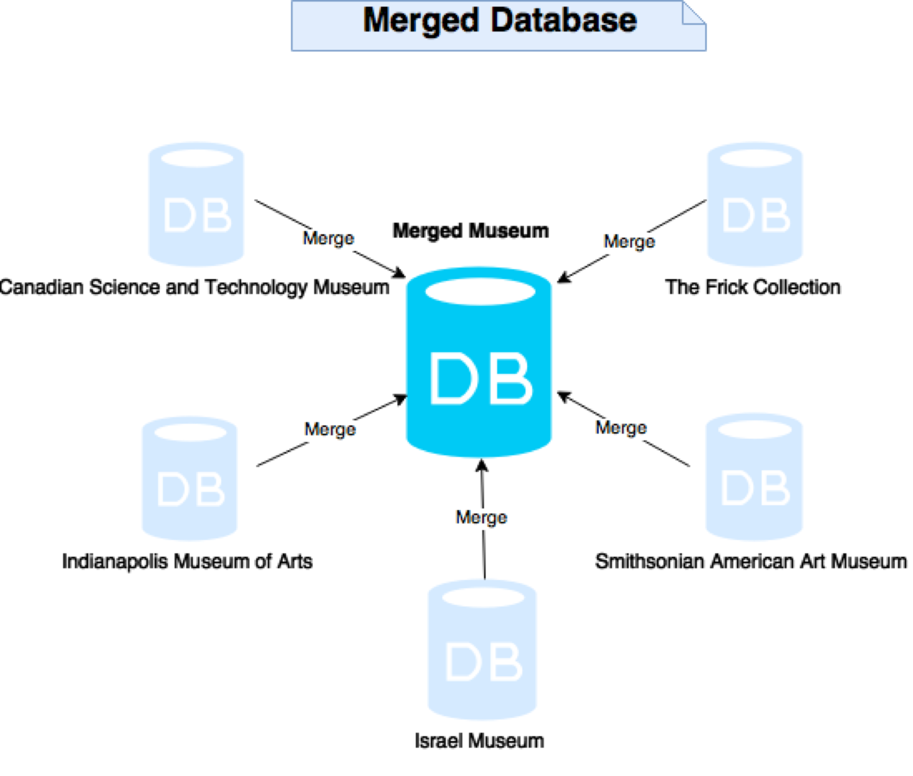

Slide 3
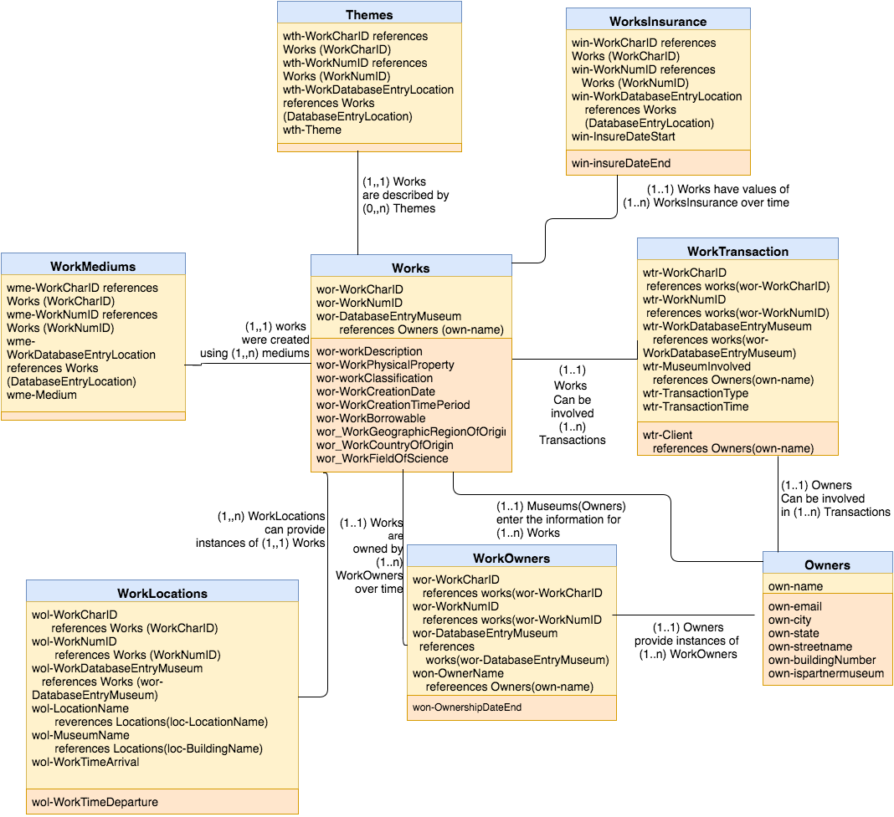
Works

Slide 4
Work Categorization
Method 1
Types
Painting
History Painting
Portrait Art.
Landscape Painting
Clocks
Mantel
Pendant
Textile Art
Tapestry
Carpet
Method 2
Types
Computing Technology
Digital Peripheral Devices
Analog Computing Devices
Astronomy
Observation Equipment
Research Commemorative
Photography
Cine Cinemas
Computing Devices
Method 3
Types
Metal Work
Painting
Furniture
Clothing
Subtypes
Asian Art
American Modernism
Decorative Arts
Native Arts of the Americas
Extra Descriptive Categories
Human Creation
The Natural World
Artistic Intricacy
The Human Body
War Pieces

Slide 5
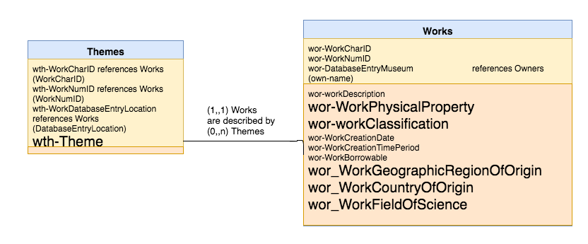
Work Categorization

Slide 6
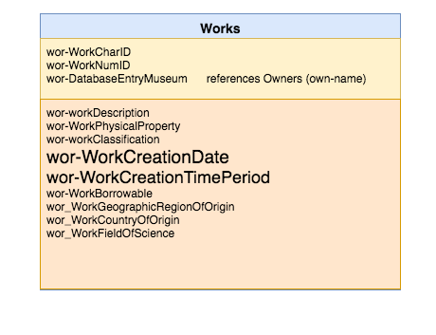
Work Creation Dates

Slide 7
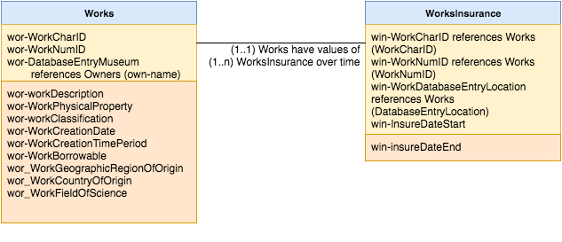
Work Insurance Values

Slide 8
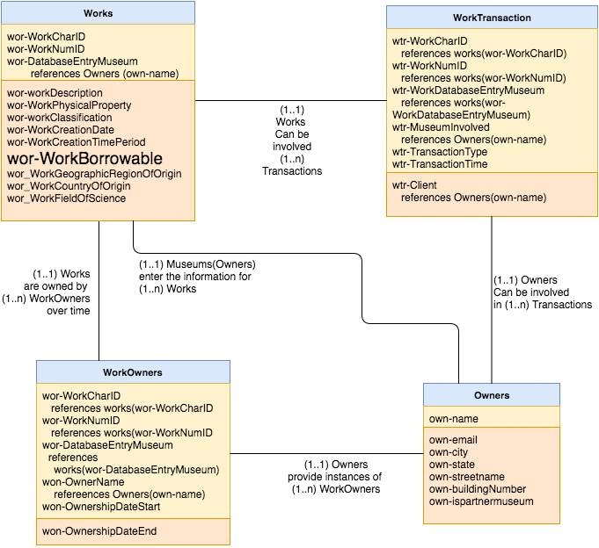
Transactions

Slide 9
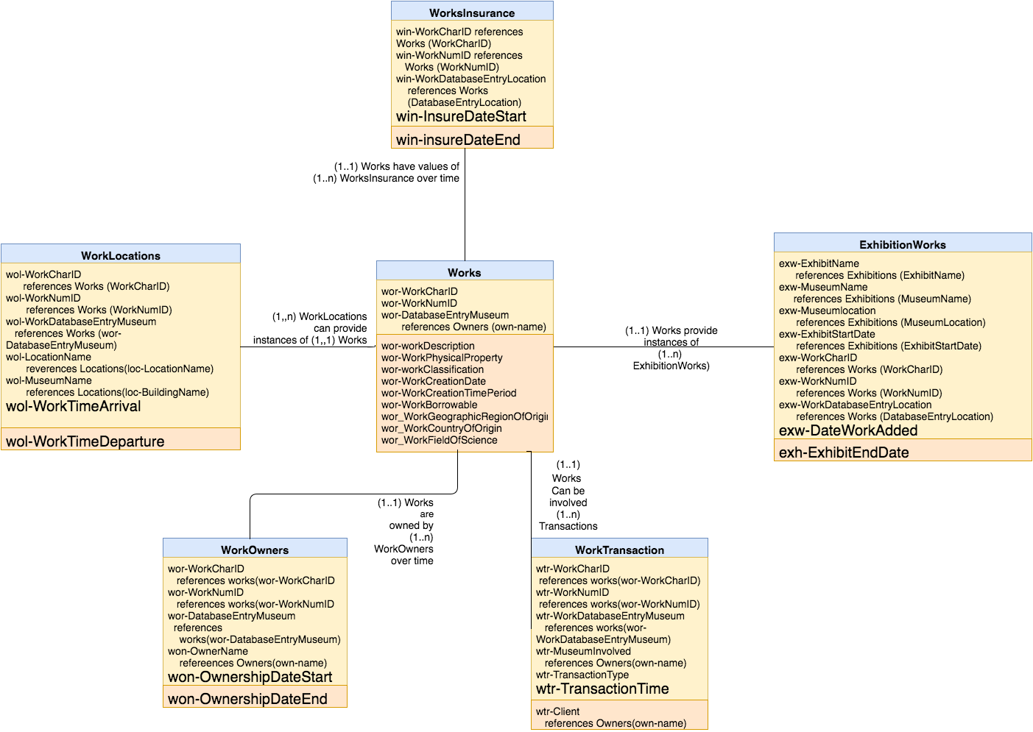
Management of
Temporal Data
Pertaining to Works

Slide 10
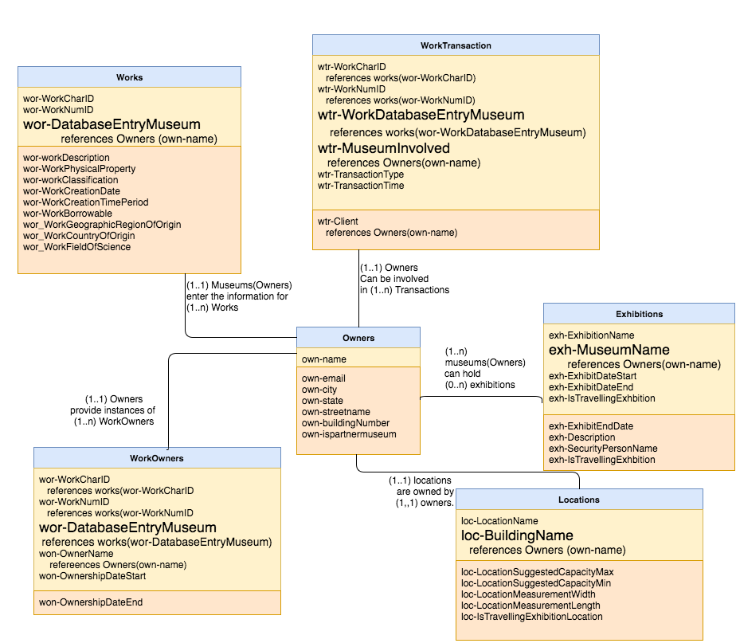
Keeping
Records
Unique

Slide 11
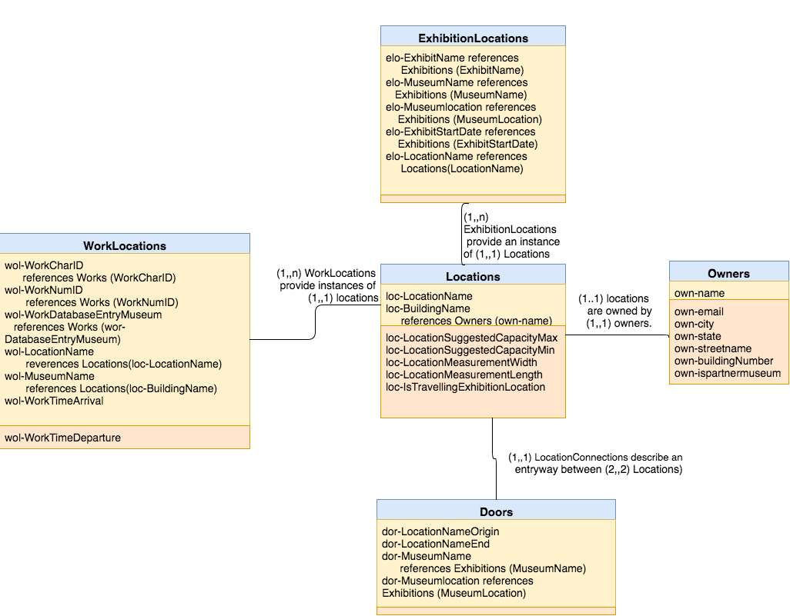
Locations

Slide 12
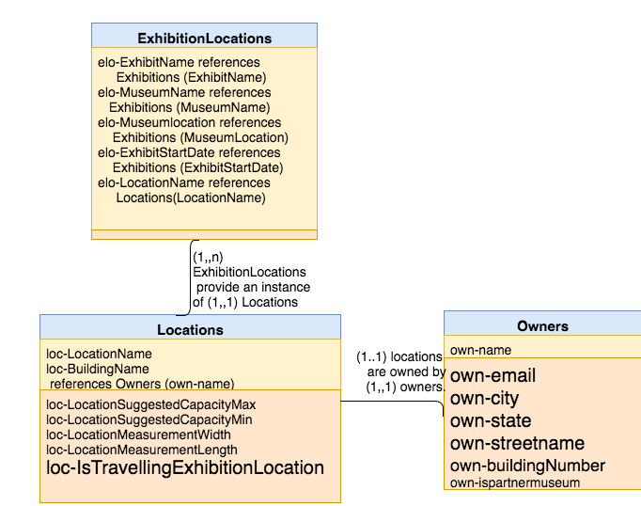
Management
Of Locations
For Travelling
Exhibitions

Slide 13
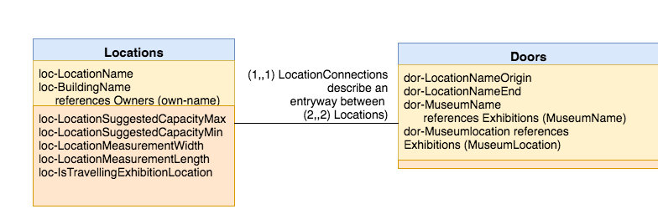
Doors

Slide 14
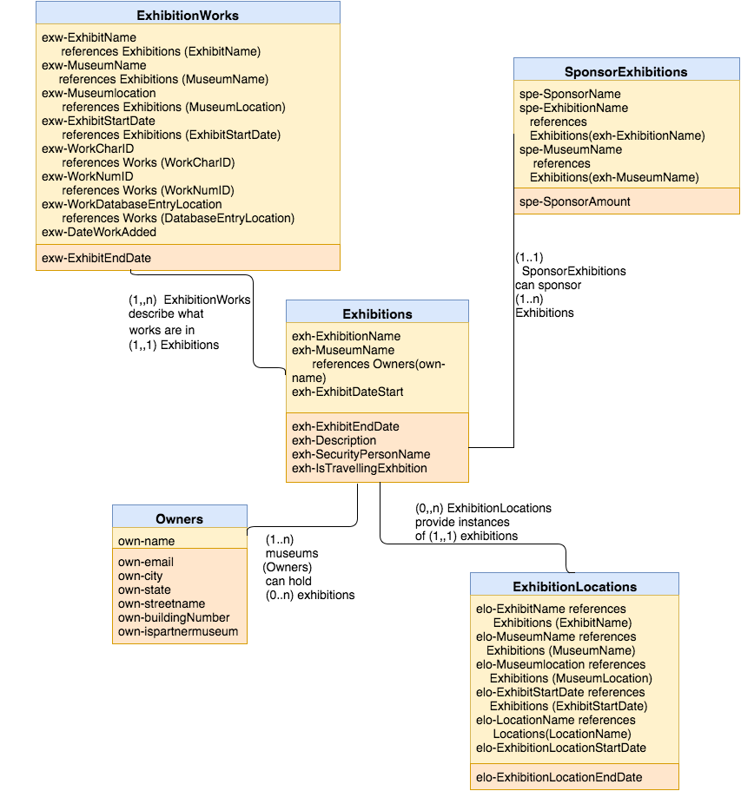
Exhibitions

Slide 15
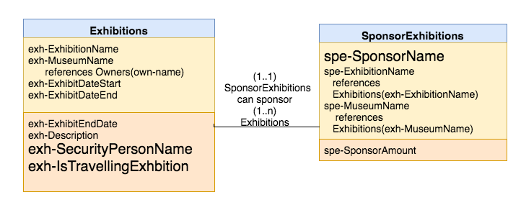
Management of
Travelling Exhibitions

Slide 16
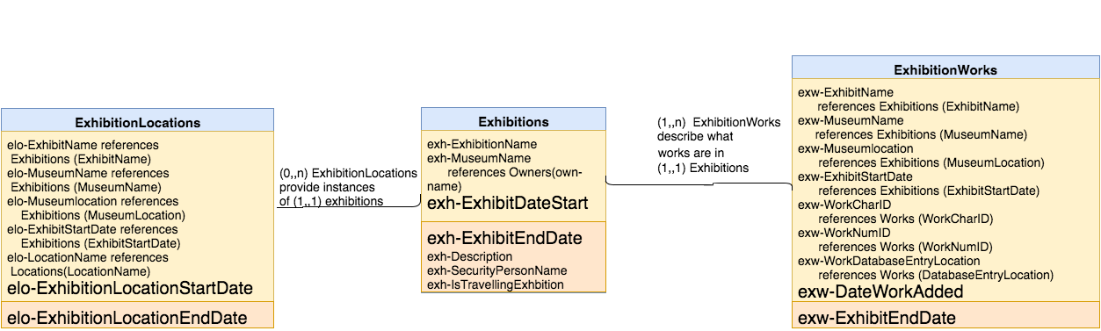
Management of Temporal
Data Pertaining to Exhibitions

Slide 17
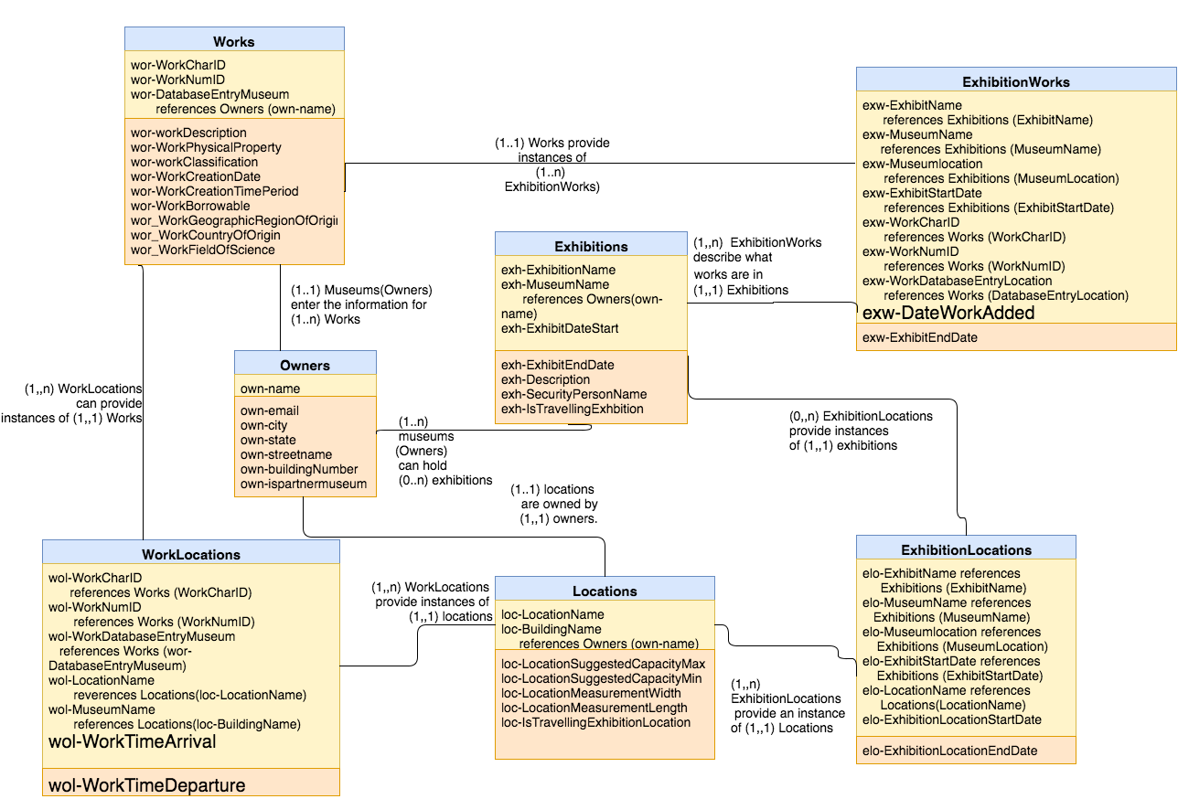
Triggers

Slide 18
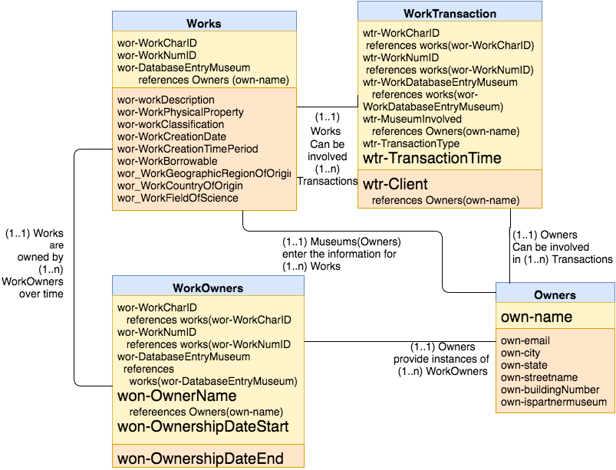
Triggers

Slide 19
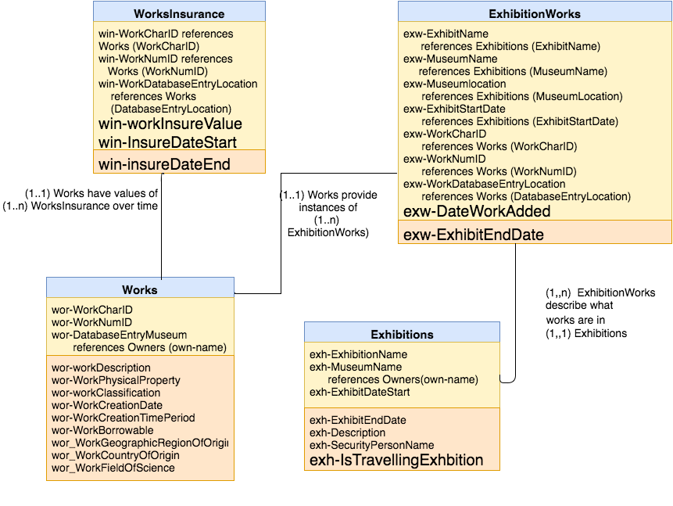
Triggers

Slide 20
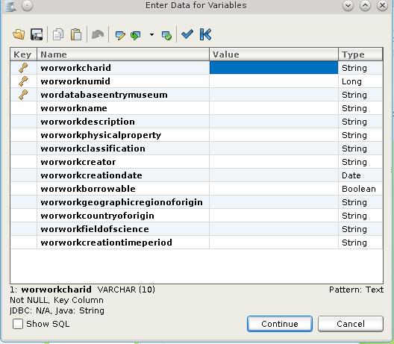
Transactions for adding, updating, and removing data
-Each table in our new database design has a graphical user interface to insert, delete, or update data. All of these are accessible via DBVisualizer and are easy to use with no programming skills required.

Slide 21
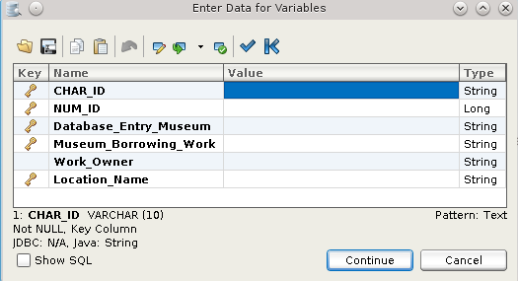
Special Multi-Table Transaction # 1
This is a multi-table transaction that is higher level, allowing the database to process the purchase of a new work for the museum. In a single form, a user can enter the information of a work, and it will automatically be entered into the works table, recorded as a new insurance record in the workinsurance table, and be logged as a purchase transaction in the worktransaction table.

Slide 22
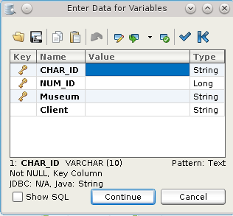
Special Multi-table Transaction #2
This is a multi-table transaction that is meant to be user friendly to process selling a work that belongs to a museum. Through filling out the form, the data entered by the user automatically logs the work into the worktransaction table as being sold, and creates a new record of ownership and sets and end date of the previous record in the workowners table.

Slide 23
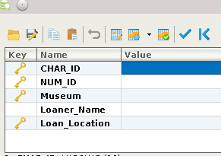
Special Multi-table Transaction #3
This is a multi-table transaction that is meant to be user friendly to allow a user to process the loaning of a museum work to another museum. Through filling out the form, a transaction is created, and the location of the work is updated in the worklocations table by inserting the new location and setting the end date for the old location.

Slide 24
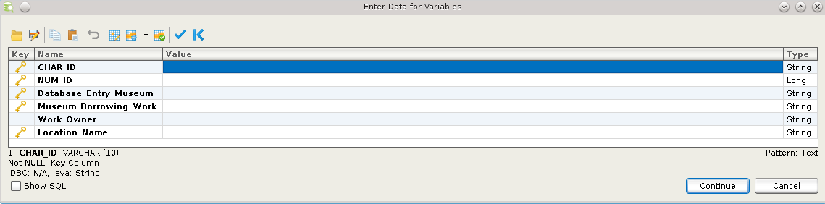
Special Multi-Table Transaction #4
This is a multi-table transaction that is meant to be user friendly. It allows a user to create a log in the system of borrowing a work. By filling out the form, the work being borrowed is recorded as a transaction and its location is updated and previous location ended, similiar to the loaning of a work.

Slide 25
Special Multi-Table Transaction #5
This transaction processes the selling of works between museums. It logs it as a transaction and changes the works location and the works owners and updates all applicable information with regards to the object in the workowners, worklocations, and transactions table.

Slide 26
Special Multi-table transaction #6
This transaction is meant for a new owner purchasing a work. Throughout filling a single form, a new owner is added to the system, the ownership of the work updated and transferred to them, and the transaction of this logged in the transactions table.

Slide 27
Part H Presentation

